Slide 1
Python for .NET Devs
Janier Davila
@janierdavila

Slide 2
Who is this talk for?
Assumes no prior python knowledge
.Net developers who want to learn python
Introductory session

Slide 3
What is Python?
Created in 1990 (30 years ago!) by Guido van Rossum
OSS Programming Language (CPython)
Interpreted, high-level, general-purpose
Uses dynamic type system
Strongly type
Huge standard library (batteries included)
Sponsored by Python Software Foundation

Slide 4
What is Python?
Multi-paradigm (Functional, Imperative, Object-Oriented)
Automatic memory management
Latest version is 3.8 (Oct 14th, 2019)
Uses whitespace indentation
Easy to learn and to read
Uses English keywords

Slide 5
Python IDE/Editor
VS Code with Python extension
PyCharm
Sublime
Visual Studio with Python Tools

Slide 6
Zen of Python
Beautiful is better than ugly
Explicit is better than implicit
Simple is better than complex
Complex is better than complicated
Flat is better than nested
Readability counts
If the implementation is hard to explain, it’s a bad idea

Slide 7
Python import statement
import [module]
from [module] import [function/callable]
from [module] import *
from pprint import pprint as pp
Notes:
Import statistics
a = [0, 1,1, 3, 4, 9, 15]
statistics.mean(a)
statistics.media(a)
statistics.stdev(a)

Slide 8
Python data types
bool
bytes
int
float
str
list, dict, set, tuple
None
Notes:
INT
=========
Import math
math.factorial(100)
Talk about int.Maxvalue 2 ** 31 – 1
Int = Unlimited precision signed integer
Binary = 0b10, octo = 0o10, hex = 0x10
Int(-3.5) use constructor to convert
Float (53 bits of binary precision. 15 to 16 bits of decimal precision)
=====
3e8 = speed of the light
You can use float() constructor to convert.
Bool (True or False)
============
Talks about falsy and truthy using bool constructor
Use sample with comparison operators
Str (immutable sequence of Unicode codepoints)
=========================
Use single or double quote
Multiline strings “””
Raw strings
Escape characters
Sequence type
Use capitalize method
Bytes (Immutable sequence of bytes)
========================
Support most of the same operations as str
To convert to string, you need to decode
List (mutable sequence of objects)
=====================
A = [1 ,2 ,3 ,4]
List constructor
Dict (mutable mappings of keys to values)
=======================
A = {k1: v1, k2:v2}
Tuples (immutable sequence of arbitrary objects)
=========================
T = (“Janier”, 36)
Len(T)
Concatenate with + and repeated with *
unpacking
K = (3,)
Empty = ()
Parenthesis optional

Slide 9
Python conditional statements
if
elif
else
conditional expression

Slide 10
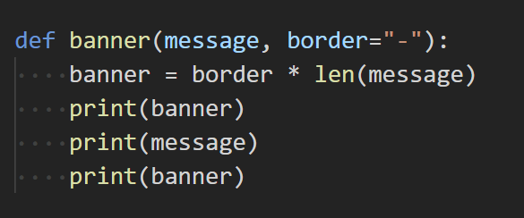
Python functions
Use def to define a function

Slide 11
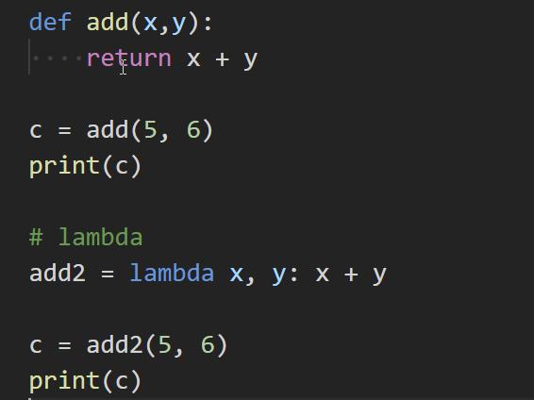
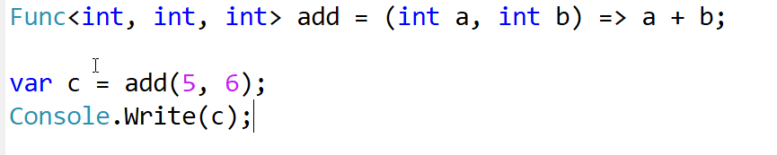
Python lambda
Use lambda arguments: exp to define a lambda

Slide 12
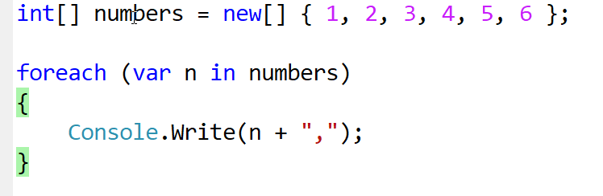
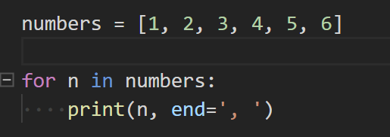
Python loops and iterators
for
while
ranges
iterable
iterator
Notes:
Also talk about break, continue

Slide 13
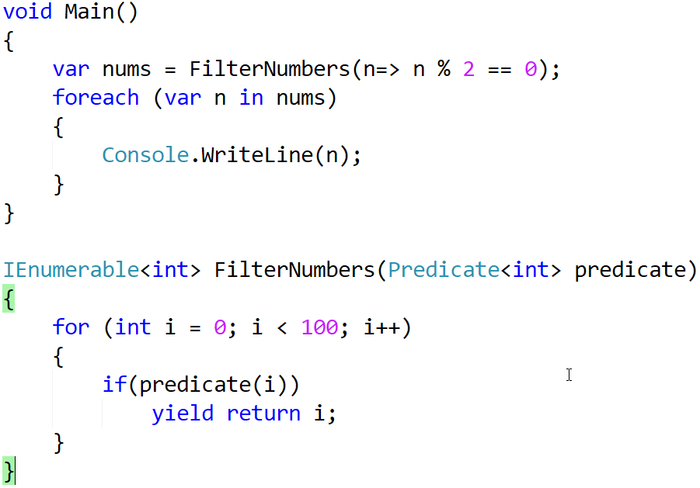
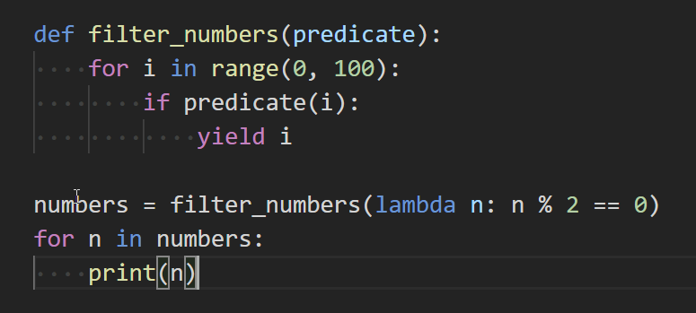
Python yield

Slide 14
Python comprehensions and generators
List comprehension
dict comprehension
set comprehension
generators
Notes:
L = [x * 2 for x in range(10) if x % 2 == 0]
G = (x * 2 for x in range(10) if x % 2 == 0)

Slide 15
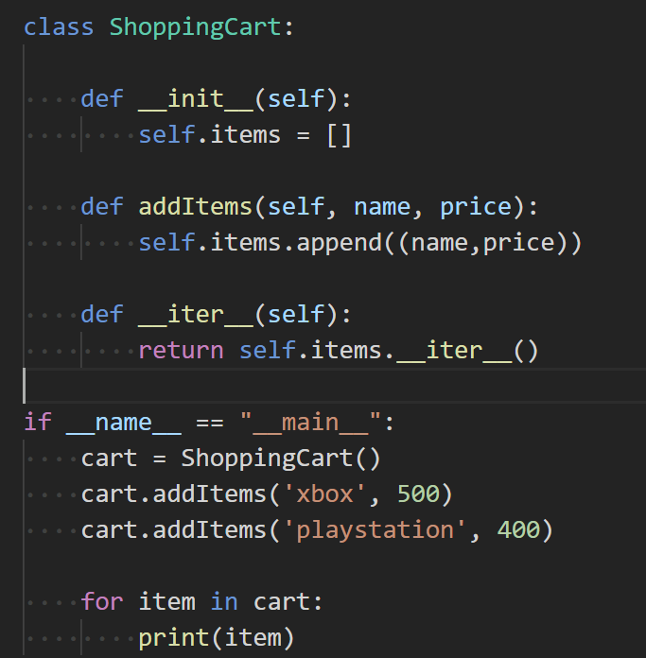
Python classes
Notes:
from enum import Enum
class Color(Enum):
RED = 1

Slide 16
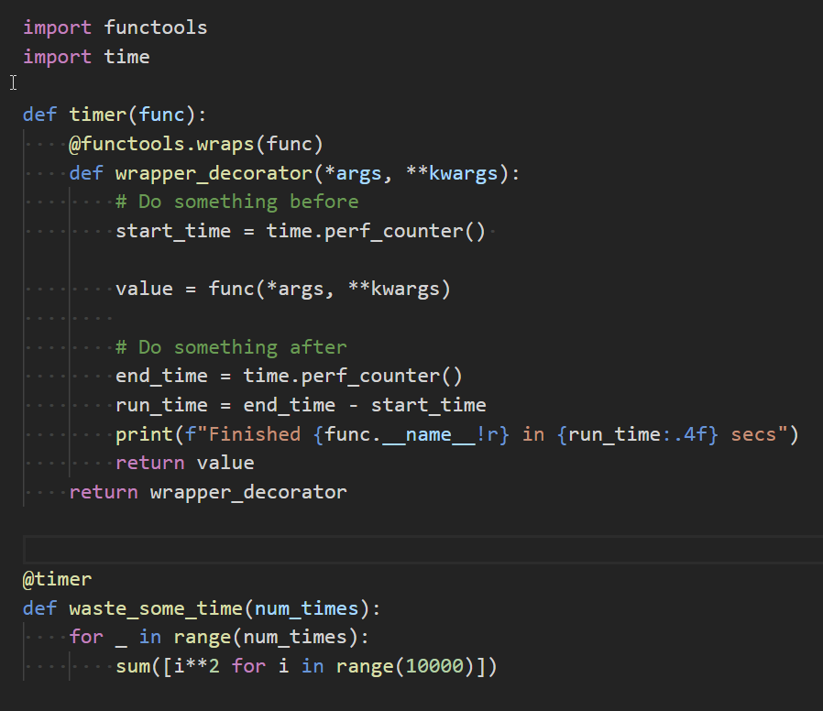
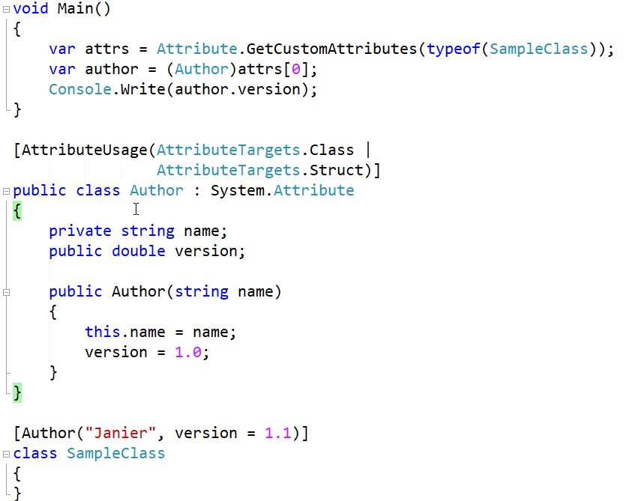
Python decorators

Slide 17
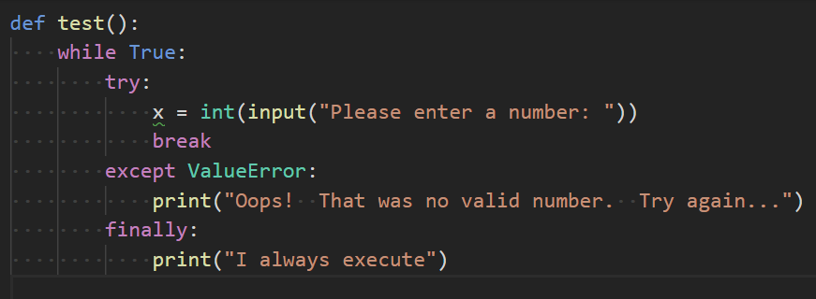
Python exceptions
try
except
finally

Slide 18
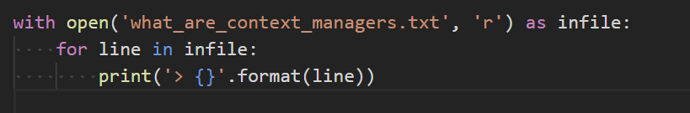
Python context managers
with
Notes:
Use code sample

Slide 19
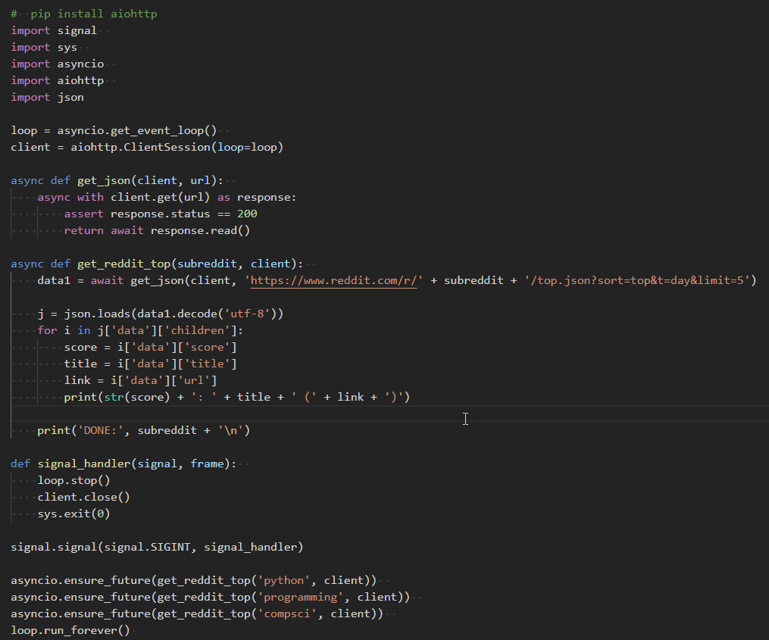
Python async/await
Notes:
Use code sample

Slide 20
Python usage
Top 10 language since 2003
Scientific computing (NumPy, SciPy, Matplotlib)
Web (Flask, Django)
IT Admin and DevOps
Machine learning (TensorFlow)
Included in Linux and Raspberry Pi
Wikipedia, Google, Yahoo!, CERN, NASA, Facebook, Amazon, Instagram, Spotify

Slide 21
THANK YOU

